Slide 1
ASSIGNMENT 2 DATA 1205 DEBOPRIYA DATTA (100997901)

Slide 2
agenda
Counts of the number of trends in the company
Attrition by Gender (Churns by Gender)
Department Wise Attrition
Number of Employee by Age Group
Employee Job Satisfaction from each department
Education Field Wise Attrition
Attrition Rate by Gender for Different Age Group

Slide 3

Question Collect, visualize data and provide insights. Collect your data or choose from the dataset dump on the course homepage. Generate a minimum of 5 different graphics and a maximum of 10 PowerPoint slides. Provide verifiable insights in the caption of each chart in the worksheet, export the workbook to PowerPoint and insert a summary of insights slide into the PowerPoint. Data characteristics: 500 rows by 5 columns minimum.

Slide 4
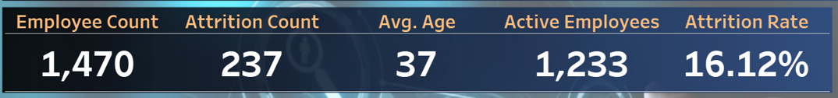
Counts of the number of trends in the company
Impact of Attrition on Employee Count: There are 1,470 workers in total, 237 of whom have departed the company.
After attrition, the organization now has 1,233 active employees. Assessment of Attrition Rate: The personnel turnover rate is moderate to high, as indicated by the attrition rate of 16.12%. Higher hiring and training expenses could result from the company's inability to retain workers if this trend persists. Workplace Demographics: The workforce is mid-career, with an average age of 37 years.
This implies that opposed of being entry-level workers, the majority of employees may be seasoned professionals.

Slide 5
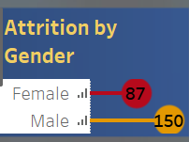
Attrition by Gender (Churns by Gender)
Breakdown of Attrition by Gender: Attrition of Female Employees: 87 Attrition of Male Employees: 150 237 workers were attrited overall, which is in line with the earlier chart.
Comparison and Important Findings: Male attrition is higher than female attrition (150 vs. 87). This may indicate that possibilities for career progression, job discontent, or industry-specific trends are among the reasons why males are more inclined to quit their jobs. To ascertain if this is a noteworthy trend or the outcome of the general workforce distribution, it is crucial to take into account the overall male-to-female worker ratio.
Implications for Business: Influence of Workplace Diversity: Despite having a lower share of the workforce, female employees may have a bigger proportional influence due to their lower turnover rates.

Slide 6
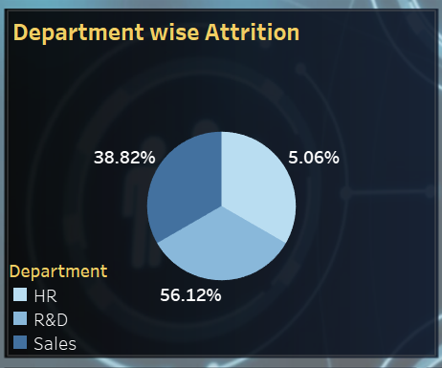
Department Wise Attrition
Department-wise Attrition Chart Insights: R&D has the highest attrition rate (56.12%): the majority of departing personnel are from this department. Moderate Attrition: Sales (38.82%): Not as high as R&D, but still noteworthy. HR has the lowest attrition rate (5.06%), which is quite low when compared to other departments.
Key Takeaways: Research the causes of R&D attrition (work pressure, lack of career advancement, etc.) as it may affect innovation and long-term growth. Attrition in sales is significant.

Slide 7
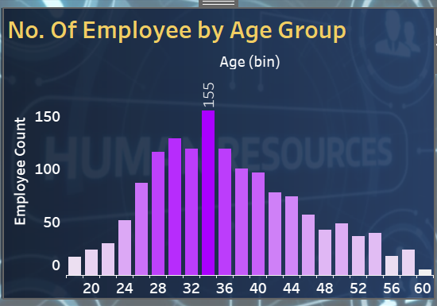
Number of Employee by Age Group
Insights: Age Group of 33 – 35 has the highest employee count (155): the majority of employee count are from this age group. Age Group of 29 – 31 has the moderate employee count (130): the average of employee count are from this age group. Age Group of 0 – 10 has the lowest employee count (60 and above): the majority of employee count are from this age group. Key Takeaways: Research the causes of Employee group attrition (the cause of employment, etc.) as it may affect work term and long-term growth.

Slide 8
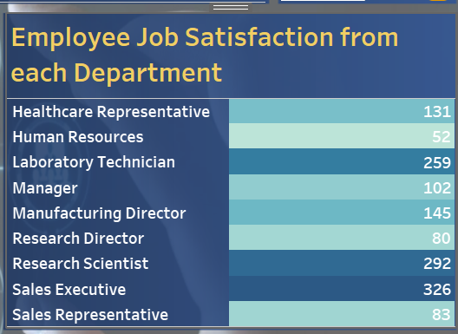
Employee Job Satisfaction from each department
Insights: Majority of the job satisfaction can be seen from the Sales Executive Department with 326 votes while the least job satisfaction can be seen from the Human Resources Department with 52 votes.
Key Takeaways: Improvement should be done on the job training and the benefits of the employees in each department for a better job satisfaction rate.

Slide 9
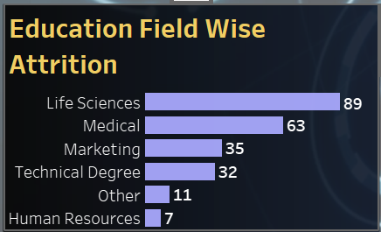
Education Field Wise Attrition
Insights: The majority of the education related field working in the company can be seen from the Life Sciences Department with 89 count while the least can be seen from the Human Resources Department with 7 count and the moderate being Marketing with 32 count.
Key Takeaways: Shows an overall acceptance in each field applying or showing interest working in the company.

Slide 10
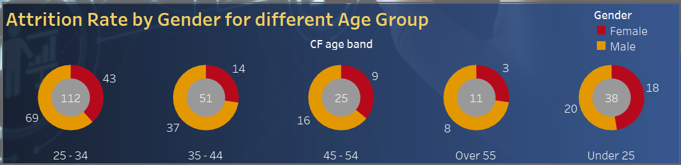
Attrition Rate by Gender for Different Age Group
Insights: the highest attrition has been done in the age group of 25 - 34 and by gender, ratio of males surpass the ratio of females by a difference of 112 which shows a complete work life balance too for the females.
Key Takeaways:
More attention should be given in the enhancement of trying to keep workers in the company, reducing the attrition rate by the gender as well.

Slide 11
FINAL INSIGHTS FROM THE DASHBOARD
THE COMPANY HAS 1470 EMPLOYEES , WITH 237 ATTRITION CASES AND AN OVERALL 16.2% ATTRITION RATE.
THE TREND BEING THAT THE AVERAGE EMPLOYEE RANGE IS AROUND 37 YRS OLD.
A HIGH ATTRITION RATE OVERALL SUGGESTS THAT THERE SHOULD BE AN IMPROVEMENT ON THE RETENTION STRATEGIES.
IT ALSO SHOWS A GENDER STRENGTH ANALYSIS BY A LOLLIPOP CHART SHOWING A WORK LIFE BALANCE.
THERE SEEMS TO BE A HIGH ATTRITION RATE IN THE R&D DEPARTMENT (56.12%) IN THE PIE CHART ANALYSIS.
THROUGH THE BAR CHART WE CAN CLEARLY UNDERSTAND THAT MAJORITY OF THE EMPLOYEES BELONG TO A YOUNGER AGE GROUP (AVG 26 - 35).
THE LOWEST SATISFACTION IS SEEN IN THE HUMAN RESOURCES DEPARTMENT WHILE THE HIGHEST IS SEEN IN THE SALES DEPARTMENT THROUGH THE HEAT MAP.
ANOTHER UNIQUE ANALYSIS OF THE DONUT CHART REVEALS THAT YOUNGER EMPLOYEES(UNDER 25) HAVE THE HIGHEST ATTRITION RATE BY 112% WHILE AS IT GOES OLDER (OVER 55) THE ATTRITION RATE DECREASES BY 11% , KEEPING THE MIDDLE AGE D ON A SAFER BAR.

Slide 12
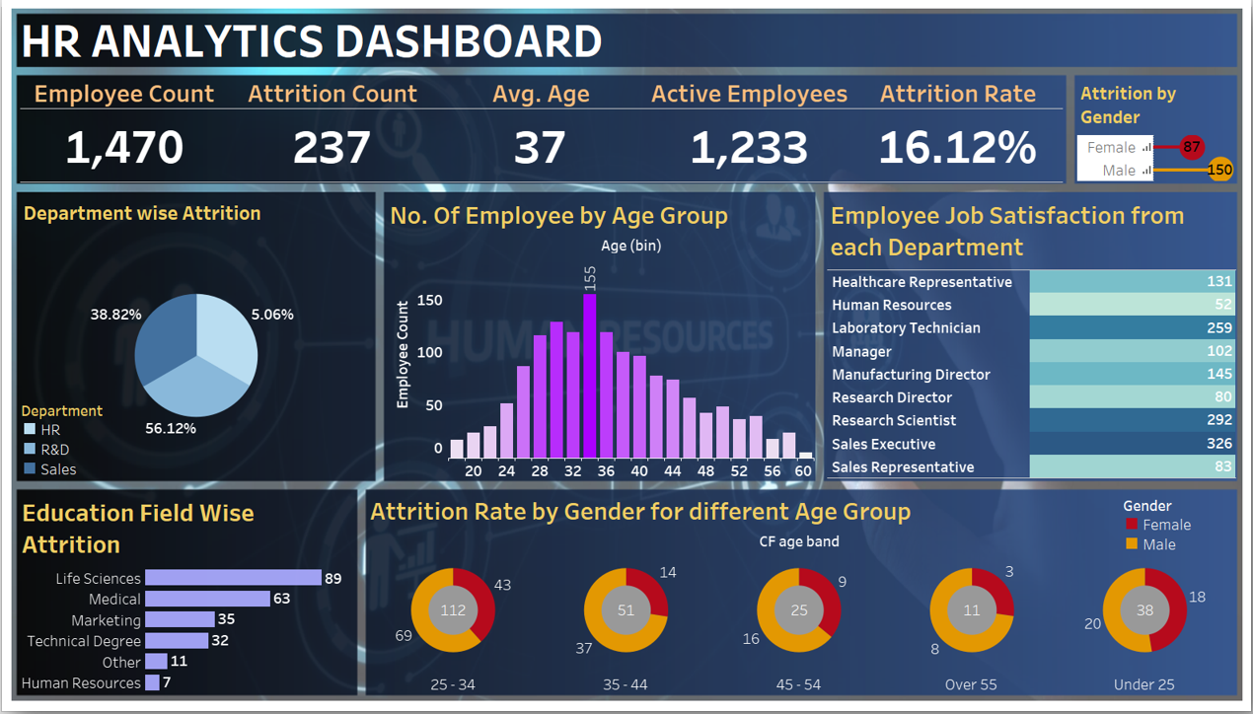
Thank you

